Slide 1

Introduction to Database Systems
DBS211
Normalization (2NF and 3NF)

Slide 2
Week 10
Introduction to Normalization: 2NF, 3NF
Lab 7 due Monday July 15th @ 11:59pm
Quiz 8 will take place in Tuesday’s class. Topic: Normalization
Project Milestone 1 due tonight @ 11:59p

Slide 3
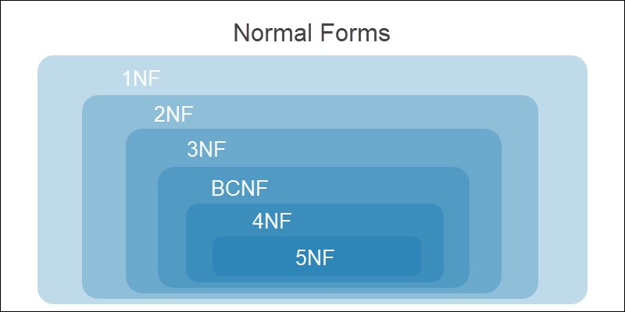
Normalization

Slide 4
Types of Dependencies
Dependencies in DBMS is a relation between two or more attributes.
It has the following types in DBMS:
Functional Dependency
Transitive Dependency
Multivalued Dependency
Partial Dependency

Slide 5
Types of Dependencies
Functional Dependency - a relationship between two sets of attributes in a database, where one set (the determinant) determines the values of the other set (the dependent).
Example:
In an employee database, employeeid (determinant) would determine the employee’s name, address, etc.
Meaning, given the employeeid, we can determine the rest of the employee information, but not vice versa.
We use mathematical notation for this
Employee ID -> Employee Name, Address etc

Slide 6
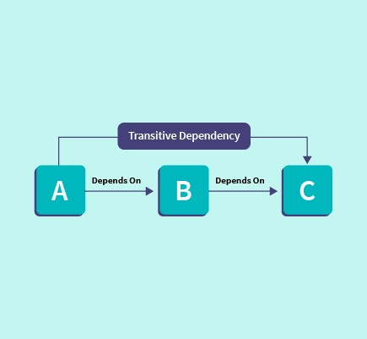
Types of Dependencies
Transitive Dependency - is an indirect dependency relationship between software components. This kind of dependency is held by virtue of a transitive relation from a component that the software depends on directly
Example: A depends on B that depends on C. So A to C has a transitive dependency

Slide 7
Multivalued Dependencies (repeating groups)
Multivalued Dependency - occurs when two attributes in a table are independent of each other but, both depend on a third attribute.
A multivalued dependency consists of at least two attributes that are dependent on a third attribute that's why it always requires at least three attributes.
Its main features include:
Ensuring efficient data storage by limiting data redundancy.
Facilitating effective querying by making database structure easier to understand
Helping in maintaining data consistency and integrity

Slide 8
Partial Dependencies
Partial Dependency - occurs when a nonprime attribute is functionally dependent on part of a candidate key. It is a situation in database normalization where a non-prime attribute is functionally dependent on only a part of a candidate key. 2NF eliminates partial dependencies.
Example:
In an Orders table, if the combination of OrderID and ProductID determines the value of CustomerID, then CustomerID is fully dependent on the primary key. However, if only OrderID decides the value of CustomerID, then CustomerID has a partial dependency on the primary key.

Slide 9
Normalization: Rules
UNF Rules:
List the attributes (fields)
Indicate multi-value attributes (repeating groups)
Choose a candidate primary key
RECEIPT [ReceiptID, CompanyName, PurchaseDate, EmployeeID, ServerName, ( TaxRate, ProductName, Quantity, UnitPrice, ) PaymentMethod, CCardNum, CCardName, ApprovalCode, IsSigned]

Slide 10
Normalization: Rules
1NF Rules:
Must be in UNF
A single cell must not hold more than one value (atomicity)
There must be a primary key for identification
No duplicate rows or columns
Each column must have only one value for each row in the table
RECEIPT [ReceiptID, CompanyName, PurchaseDate, EmployeeID, ServerName, TaxRate, PaymentMethod, CCardNum, CCardName, ApprovalCode, IsSigned]
RECEIPT_PRODUCT [ProductID, FK ReceiptID, ProductName, Quantity, UnitPrice]

Slide 11
Normalization: Rules
2NF Rules:
Must be in 1NF
Has no partial dependencies. (All non-key attributes are fully dependent on a primary key)
CourseName → StudentID (since CourseName depends on part of the primary key, which is StudentID)

Slide 12
Normalization: Rules
3NF Rules:
Must be in 2NF
Has no transitive partial dependencies.

Slide 13
2NF – Partial Dependencies
Rules:
Begins already in 1NF
It needs to identify and address partial dependencies
Partial dependencies occur when an attribute is dependent on only part of a composite primary key or on more than the primary key
To do this, each attribute in a table must be fully dependent on the entire primary key
There are 2 variations:
An attribute partially dependent on a composite primary key
An attribute dependent on more than one field, but only a single field PK exists

Slide 14
2NF – Partial Dependencies
UNF:
TEAMS [TeamID, TeamName, ShirtColour, (PlayerID, PlayerName, PlayerDOB, ShirtNumber)]
1NF:
TEAMS [TeamID, TeamName, ShirtColour]
TEAM_PLAYERS[FK TeamID, PlayerID, PlayerName, PlayerDOB, ShirtNumber]
An attribute partially dependent on a composite primary key:
2NF:
TEAMS [TeamID, TeamName, ShirtColour]
TEAM_PLAYERS[FK TeamID, FK PlayerID, ShirtNumber]
PLAYERS [PlayerID, PlayerName, PlayerDOB]

Slide 15
2NF – Partial Dependencies
An attribute dependent on more than one field, but only a single field PK exists:
TEAMS [TeamID, TeamName, ShirtColour]
TEAM_PLAYERS[FK TeamID, FK PlayerID]
PLAYERS [PlayerID, PlayerName, PlayerDOB, ShirtNumber]
2NF:
TEAMS [TeamID, TeamName, ShirtColour]
TEAM_PLAYERS[FK TeamID, FK PlayerID, ShirtNumber]
PLAYERS [PlayerID, PlayerName, PlayerDOB]

Slide 16
3NF – Transitive Dependencies
Rules:
Begins already in 2NF
It needs to identify and address transitive dependencies
Transitive dependencies are dependencies where an attribute depends on another non-pk attribute in the same entity
CUSTOMERS [CustomerID, CustFName, CustLName, CustPhone, SalesRepID, SaleRepName]
3NF:
CUSTOMERS [CustomerID, CustFName, CustLName, CustPhone, FK SalesRepID]
SALESREPS [SalesRepID, SalesRepName]

Slide 17

Summary
Normalization reminder
Functional Dependency
Transitive Dependency
Multivalued Dependency
Partial Dependency
2NF
3NF

Slide 18
Week 10
Introduction to Normalization: 2NF, 3NF
Lab 7 due Monday July 15th @ 11:59pm
Quiz 8 will take place in Tuesday’s class. Topic: Normalization
Project Milestone 1 due tonight @ 11:59p

